Slide 1
UNVEILING CINEMATIC OPPORTUNITIES
Navigating Microsoft's Dive into the Film Industry

Slide 2
Project Overview
Objective:Conduct a strategic analysis to identify successful film genres for Microsoft's new movie studio.
Goals:Explore box office trends, identify high-performing genres, and translate findings into actionable insights.
Scope: Analyze historical box office data, genre trends, and audience preferences.
Key Focus Areas:
Identify successful film genres.
Translate data into actionable recommendations.
Guide strategic decision-making for Microsoft's movie studio.
Presentation Structure:Key findings on successful film genres, actionable insights, and strategic guidance.
Conclusion: Deliver insights to empower Microsoft's new movie studio for successful content creation.

Slide 3
1.Business Understanding
Introduction
Microsoft's strategic move: Entering original video content creation.
Inspiration from industry success stories.
Goal: Establish a significant presence in the film industry.
Challenge: Lack of expertise in film production.
: Problem Statement
Analyzing current trends, genres, and audience preferences.
Actionable insights to guide Microsoft's filmmaking venture.
The challenge of navigating unfamiliar terrain in film production.

Slide 4
Defining Success Metrics
Lack of Filmmaking Expertise: Need Genre Guidance
Guiding the choice of film genres for maximum success.
Using historical box office data to explore genre trends.
Success metrics: Box office revenues, ROI, and ratings
Accurate Genre Identification and Viability Prediction
Accurate identification of genres based on historical data.
Financial viability prediction: Movies making at least 2x the budget.
Main objective: Crafting a roadmap for financially successful films.

Slide 5
Main Objectives
The main goal is to craft a roadmap for creating films that captivate audiences and thrive financially.
Specific Objectives:
Genre Mastery for Success: Identify genres with the highest potential for revenue and audience acclaim, ensuring future films align with evolving tastes.
Beyond the Basics: Influential Factors: Explore factors like budget, ROI ,studio influence, and target audience demographics to understand their impact on a film's success.
Insights for Cinematic Brilliance: Distill actionable recommendations aligning the studio's content strategy with audience preferences and market trends for increased success.

Slide 6
Questions To Consider
1.Is the film industry financially succesful? Indeed,it is depicted that more movies generate profit than losses.
2.What challenges does a business face inthis project? A significant hurdle is the lack of clear direction.
3.What factors contribute to a movie's financial success? Considerations include genre ,duration,studio, director, actor experience etc.

Slide 7
2.Data Understanding:
Utilizing data from Box Office Mojo, IMDb, TMDB Movies, and TN Movie Budgets, we focus on key tables such as "movie_basics," "movie_ratings," "movie_gross," and "movie_budgets." This includes extracting revenue trends from "movie_gross," gauging audience sentiment with "movie_ratings," exploring genre and language data, analyzing release dates, and understanding the financial aspect through "movie_budgets."
This comprehensive dataset aims to provide actionable insights for Microsoft's movie studio, guiding decisions on genre selection, release strategies, and budget planning for a successful entry into the film industry.

Slide 8
Data Preparation
Variable Handling:
In the variable selection process, we chose to drop the majority of variables, retaining only essential ones such as Gross, Budget, Genres, Runtime, and Studio.
Two new variables, ROI and profit, were created based on the Gross and Budget information.
Missing Values and Outliers:
Addressing missing values, we opted to exclude rows containing any missing data, ensuring a comprehensive analysis focused on complete information.
For outliers, a selective approach was taken, excluding certain extreme values to maintain the integrity of the analysis.
Rationale for Choices:
The decisions align with the overarching goal of making high-level, initial decisions for the studio.
The focus on broad trends in the movie industry, rather than specific details like actors or directors, is deliberate. This approach ensures insights that are broadly applicable to Microsoft's potential movie portfolio, considering the studio's early stage and the need for foundational trends rather than granular details

Slide 9
Data Analysis
Analysis Highlights:
Genre-wise Analysis: Revenue, popularity, and ROI trends for top genres.
Budget Analysis: Relationship between production budget and box office success.
Studios Analysis: Identification of top-performing studios and revenue/ROI analysis.
Time Trends: Analysis of release patterns over months/seasons.

Slide 10
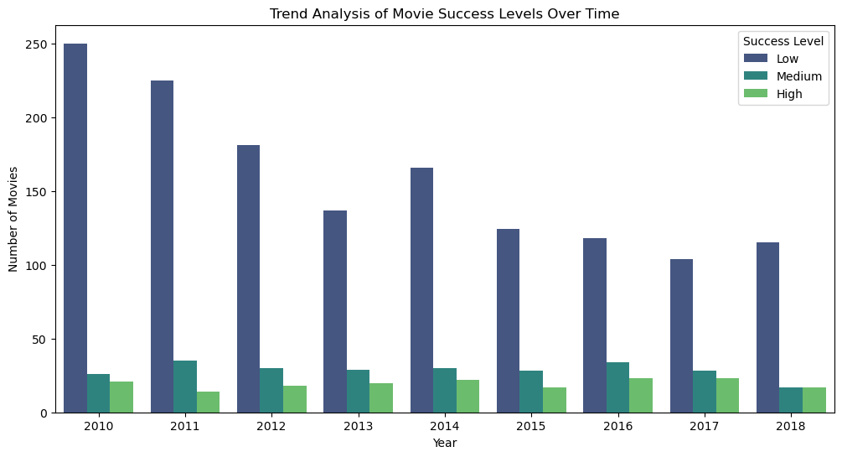

Slide 11
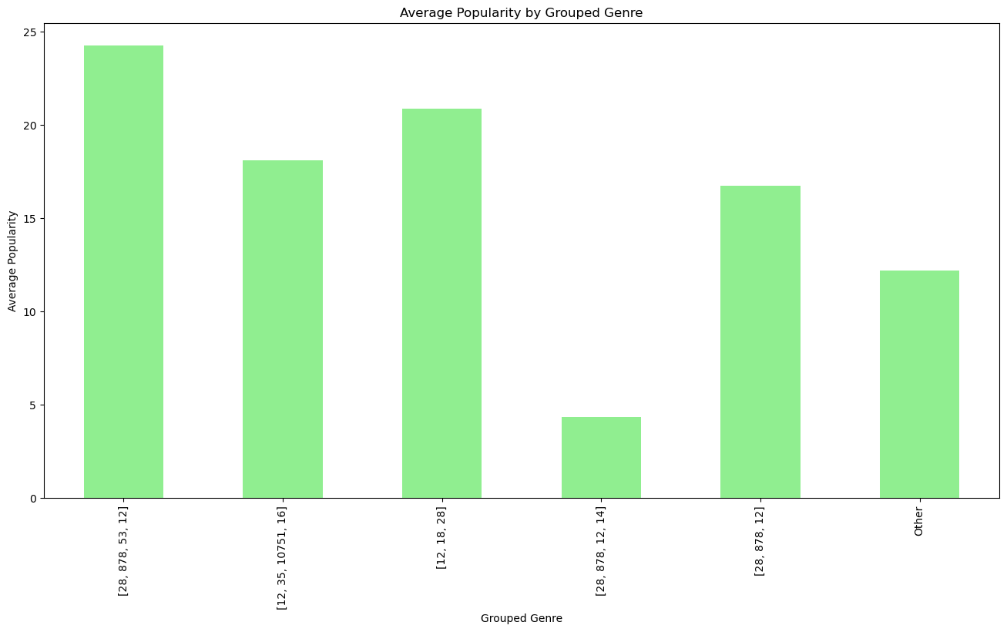

Slide 12
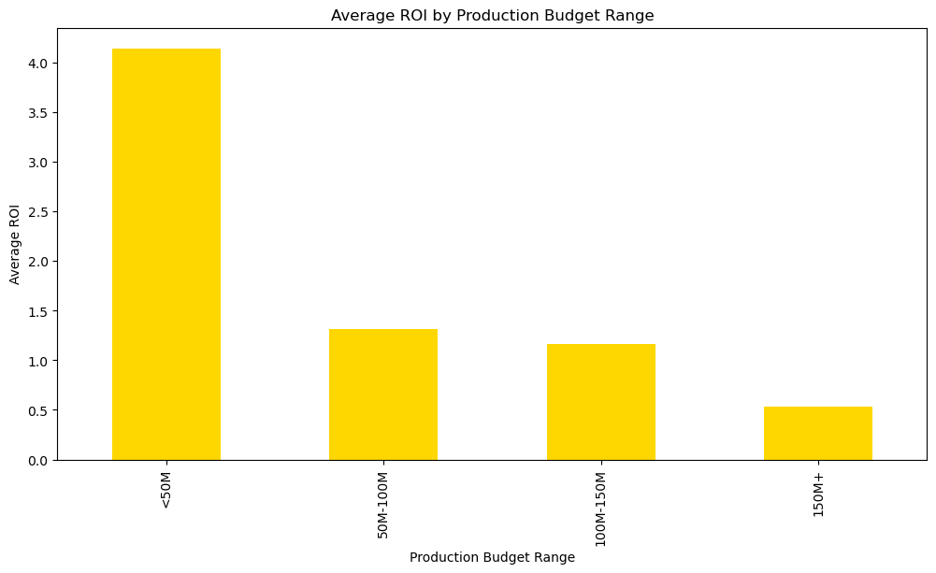

Slide 13
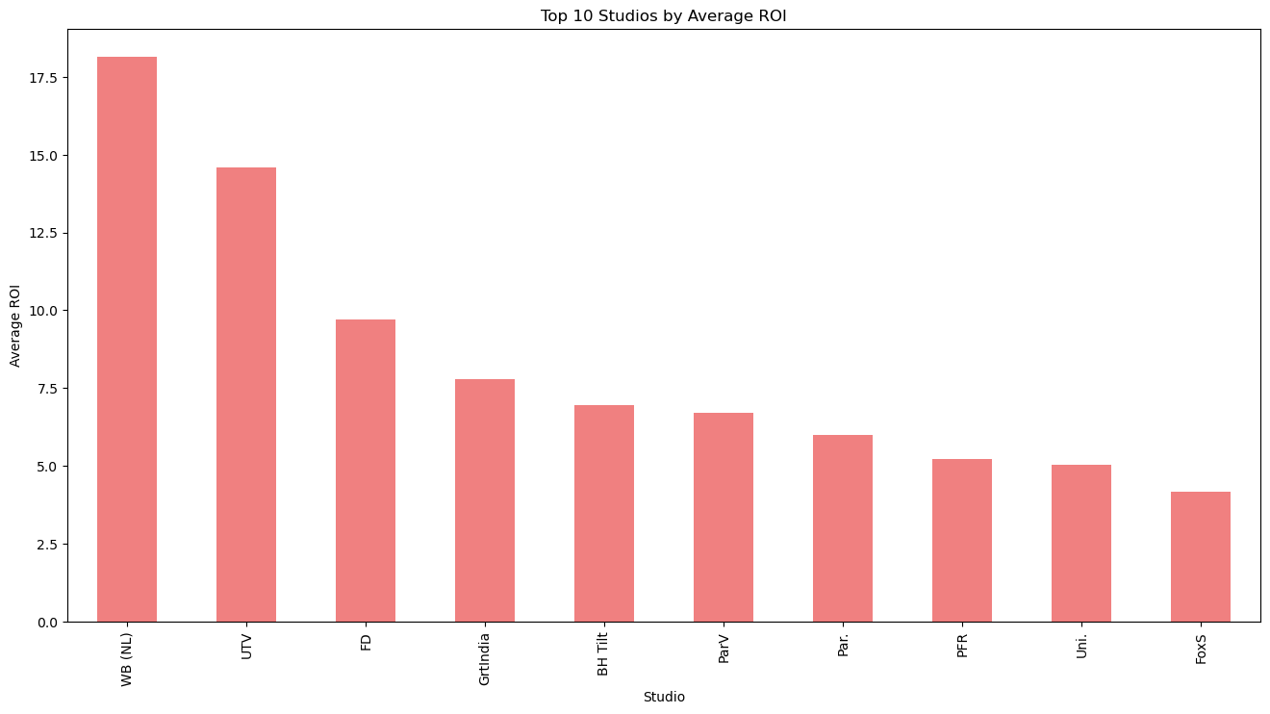

Slide 14
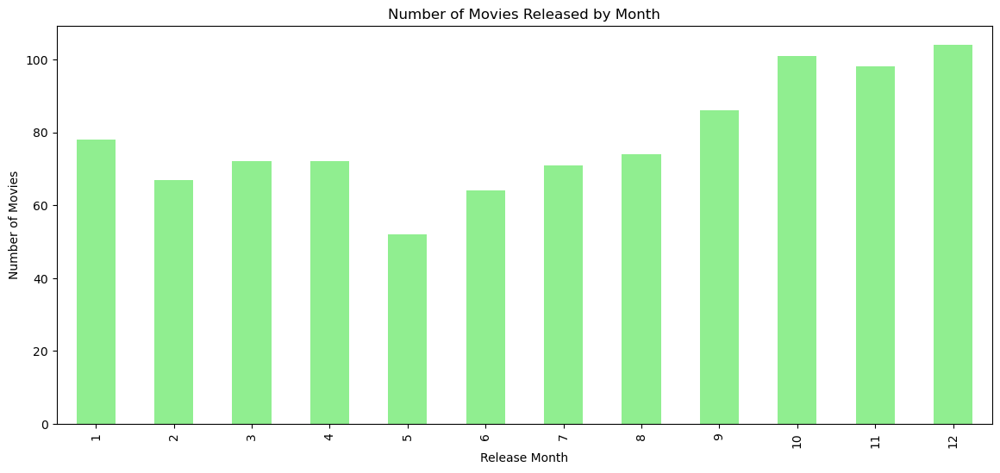

Slide 15
Conclussion
Genre-wise Insights:
Top-performing genres: Action, Adventure, Science Fiction, Fantasy, and Animation.
ROI analysis highlights profitability in Horror, Mystery, and Thriller genres.
Budget Considerations:
Positive correlation between budget and worldwide gross revenue.
Lower to moderate budgets show higher average returns; emphasize budget optimization.
Studios Performance:
Leading studios: Warner Bros., Walt Disney Pictures, and Universal Pictures.
Recommendations: Collaborate with successful studios, learn strategies, explore co-production opportunities.
Time Trends:
Potential seasonal patterns in movie releases.
Box plot analysis reveals revenue variations based on release season, guiding strategic scheduling for maximum box office success.

Slide 16
Recommendations
Genre Strategy:
Focus on top-performing genres: Action, Adventure, Science Fiction, Fantasy, and Animation, for a broad audience and high revenue.
Strategic exploration of genres like Horror, Mystery, and Thriller to maximize ROI, even with lower average revenue.
Budget Optimization:
Allocate budgets strategically, considering the positive correlation with revenue.
ROI analysis suggests lower to moderate budgets can yield better returns; prioritize cost-effective production methods without compromising quality.
Studios Collaboration:
Explore collaborations with top-performing studios through joint ventures or co-productions.
Learning from established studios' success stories can offer valuable insights for Microsoft's entry into the film industry.
Release Timing & Market Monitoring:
Leverage insights from release trends to strategically schedule movie releases.
Continuous market monitoring is crucial; adapt strategies to evolving audience preferences and trends.
Embrace content creation flexibility to remain responsive to emerging genres and audience demands.

Slide 17
Next step
Develop a comprehensive strategic plan.
Build a strong brand presence in the entertainment industry- Aim for recognition through awards and industry accolades.
Establish a robust feedback mechanism- Gather insights from audience reactions and reviews.
Develop robust campaigns aligned with release trends.
Leverage identified peak seasons for strategic releases.
Create diverse films aligning with audience preferences.
Optimize budget allocation for each production.
Align content development with audience preferences.
Explore strategic alliances with complementary industries- Tap into cross-industry partnerships for mutual benefits.
Actively participate in industry events and film festivals- Network with professionals for potential collaborations.

Slide 18
Key questions for discussion
How does the studio plan to balance its focus on top-performing genres with the need to adapt to evolving audience preferences over time?
Can you elaborate on the strategies in place to ensure the studio remains dynamic in content creation?
What approach will the studio take in striking a balance between allocating higher budgets for revenue optimization and ensuring profitability?
Are there specific cost-effective production methods the studio plans to implement to enhance ROI without compromising quality?
THANK YOU!
Email: beatrice.adhiambo@student.moringaschool.com
Github: https://github.com/Adhiambo254

